Slide 1
Basic Electronics

Slide 2
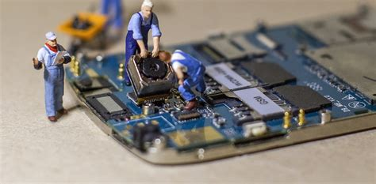
Introduction To Electronics
Electronics is the branch of science and engineering dealing with the theory and use of a class of devices in which electrons are transported through a vacuum, gas or semiconductor.

Slide 3
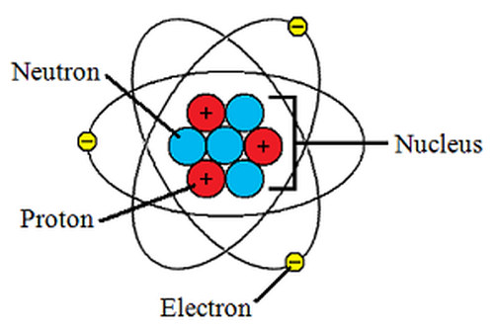
Atomic Structure

Slide 4
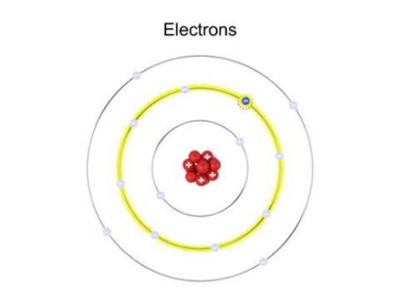
Electron
Electrons are fundamental sub-atomic particles.
They are negatively charged and move from negatively charged parts to positively charged ones.
The negatively charged pieces of any circuit have extra electrons, while the positively charged pieces want more electrons.
The electrons then jump from one area to another. When the electrons move, the current can flow through the system.

Slide 5
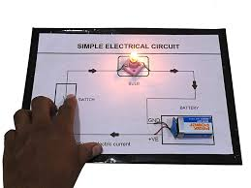
Electrical Quantities
To understand the operation of electric circuits we must familiar with electrical quantities such as charge, current and voltage.

Slide 6
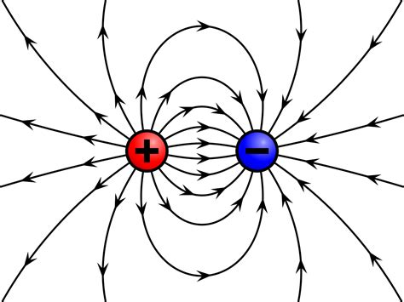
Charges
Electric charge is the physical property of matter that causes it to experience a force when placed in an electromagnetic field.
There are two types of electric charge:
Positive and Negative (commonly carried by protons and electrons respectively).
Like charges repel each other
Unlike charges attract each other.

Slide 7
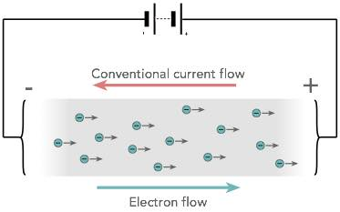
Current
Rate of flow of electrons is known as current.
I = Q / t
Where, I = Current, Q = Charge, t = Time
Unit of current (I) is ampere or A.

Slide 8
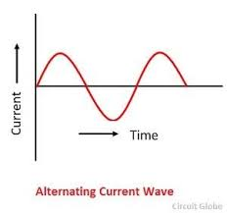
Alternating Current
Alternating current (AC) is an electric current which periodically reverses direction.

Slide 9
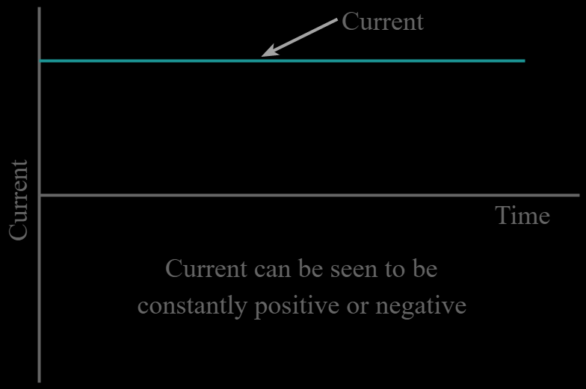
Direct Current
Direct current (DC) is the unidirectional flow of an electric charge.

Slide 10
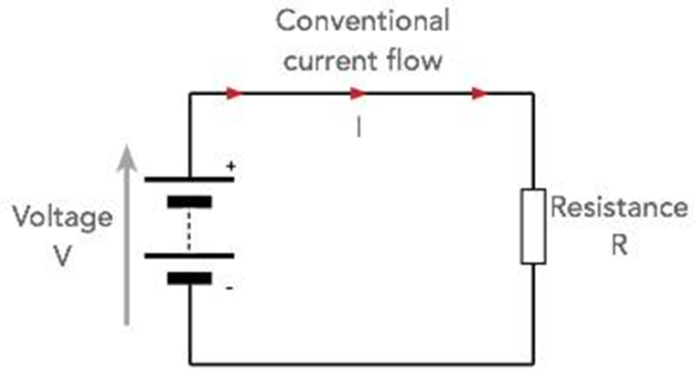
Voltage
An electromotive force or potential difference expressed in volts.
For most materials V ∝ I
V = RI,
Where, V is the voltage across the object,
I is the current through the object,
R is resistance of the object.

Slide 11
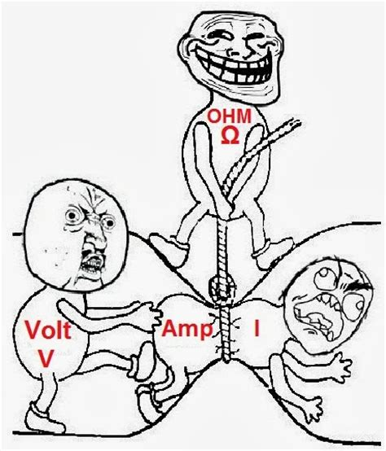
Resistance
Resistance is a measure of the opposition to current flow in an electrical circuit.
Resistance is measured in ohms, symbolized by the Greek letter omega (Ω).
It is inverse of conductivity.

Slide 12
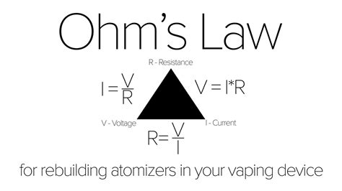
Ohm’s Law
Ohm's law states that the current through a conductor between two points is directly proportional to the potential difference or voltage across the two points.
V = I X R
I = V / R
R = V / I

Slide 13
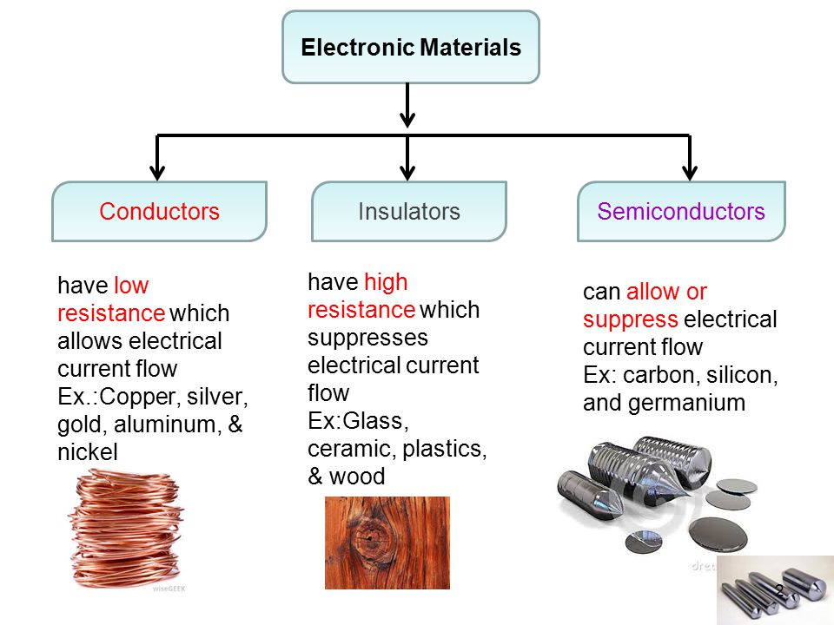

Slide 14
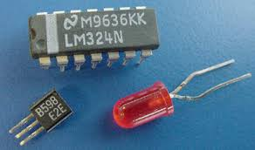
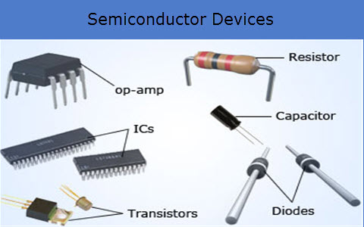
Semiconductor
• Materials whose conductivity falls between those of conductors and insulators are called semiconductors.
• Semiconductors are “part-time” conductors whose conductivity can be controlled.
Silicon is the most common material used to build semiconductor devices.

Slide 15
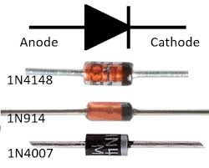
Diode
A diode is defined as a two-terminal electronic component that only conducts current in one direction. An ideal diode will have zero resistance in one direction, and infinite resistance in the reverse direction.

Slide 16
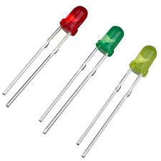
LED (Light Emitting Diode)

Slide 17
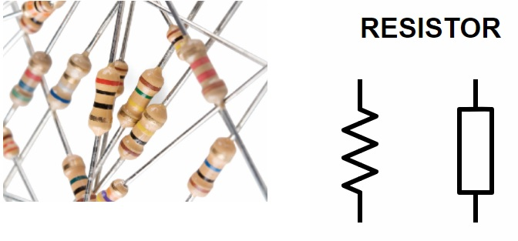
Resistor
A resistor is a passive two-terminal electrical component that implements electrical resistance as a circuit element. In electronic circuits, resistors are used to reduce current flow, adjust signal levels, to divide voltages etc.

Slide 18
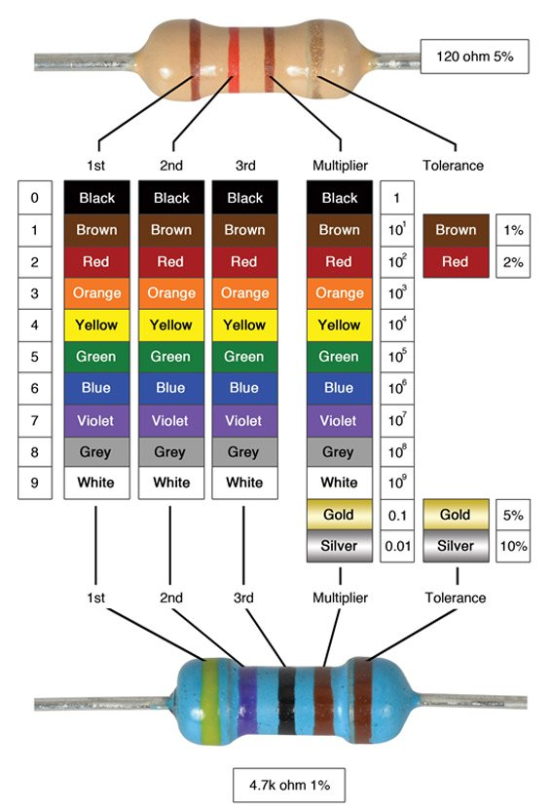

Slide 19
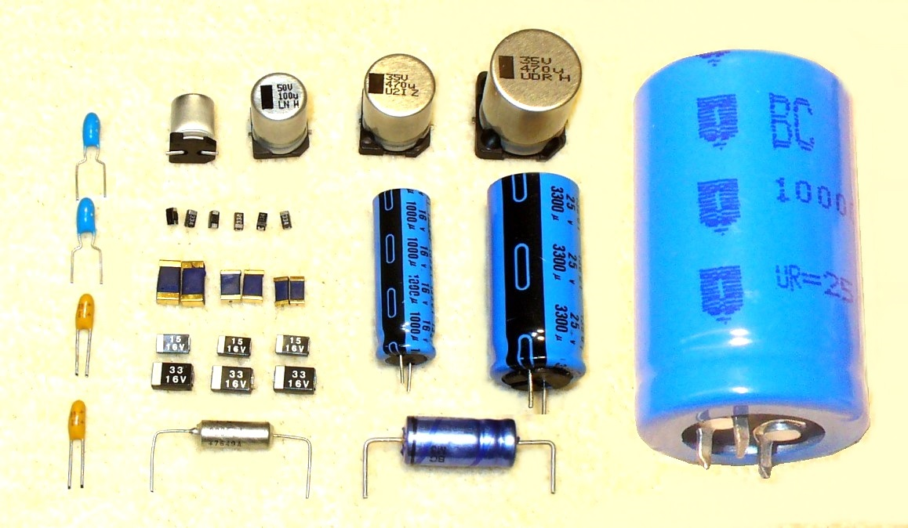
Capacitor
A capacitor is a device that stores electrical energy in an electric field. It is a passive electronic component with two terminals.

Slide 20
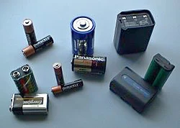
Battery

Slide 21
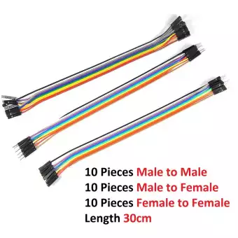
Connecting Wires

Slide 22
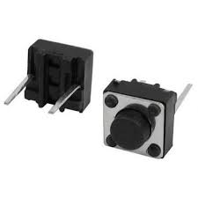
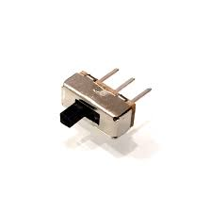
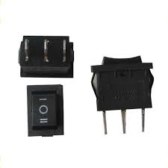
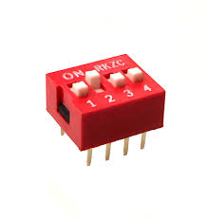
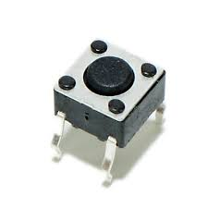
Switches

Slide 23
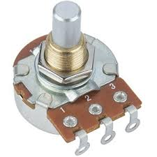
Potentiometer

Slide 24
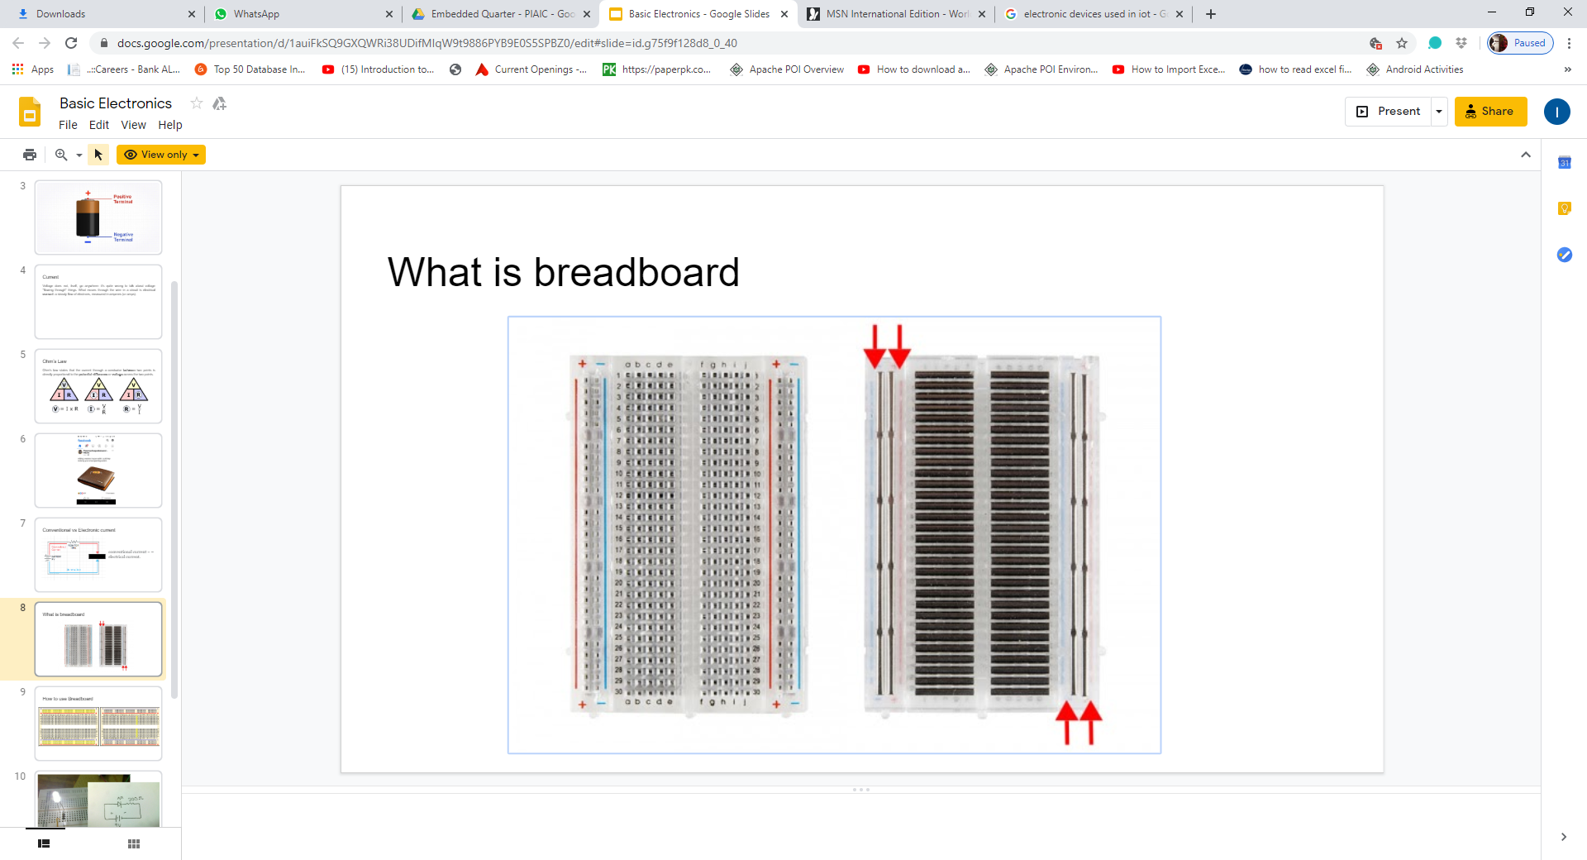
Breadboard

Slide 25
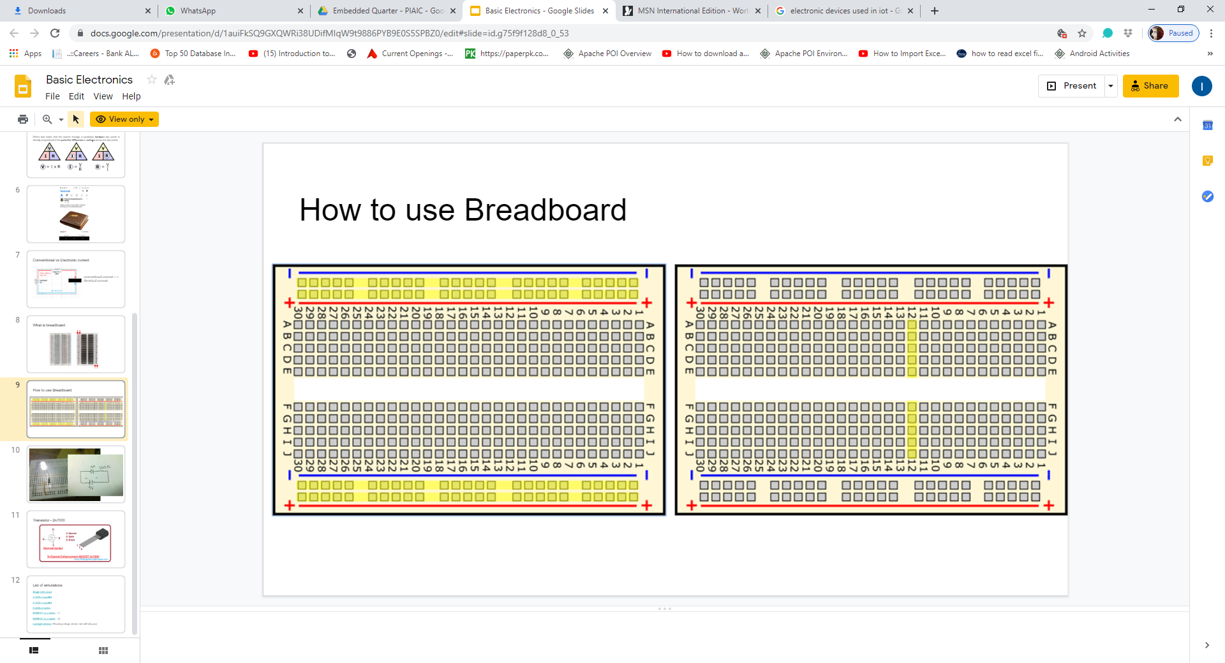
How to use Breadboard?

Slide 26
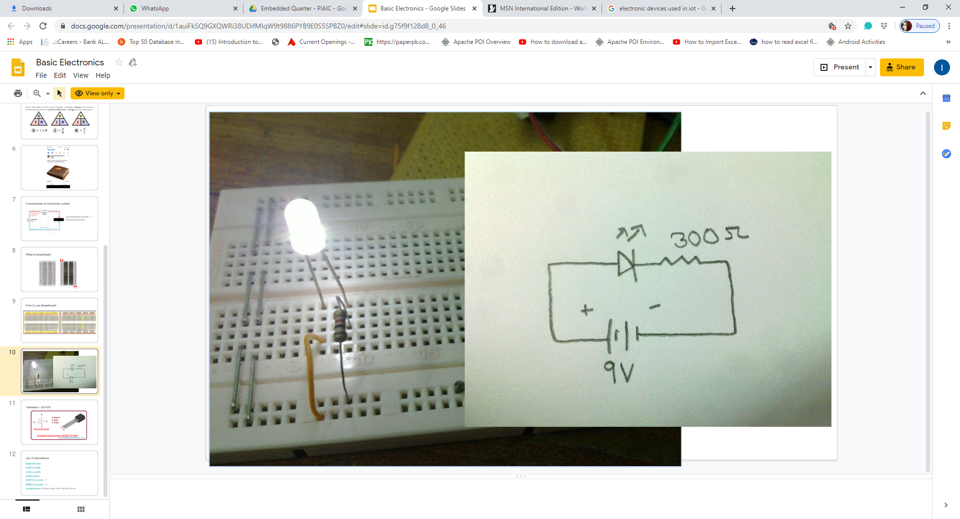

Slide 27
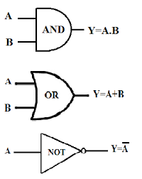
Logic Gates

Slide 28
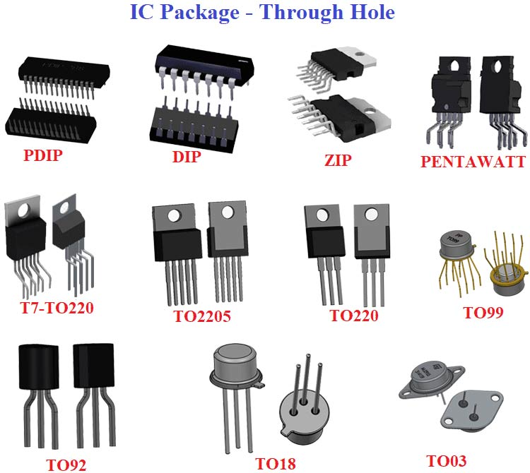
ICs (Integrated Circuits)

Slide 29
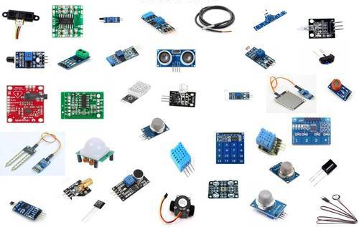
Sensors

Slide 30
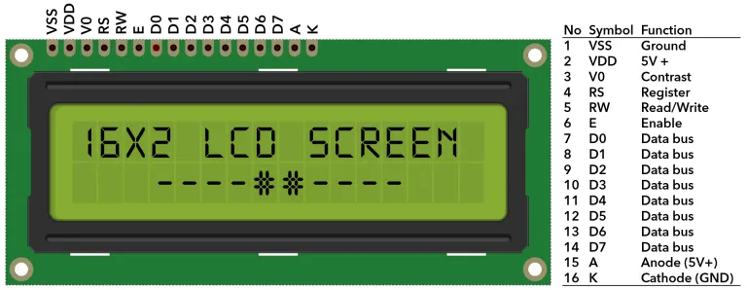
LCD Display

Slide 31
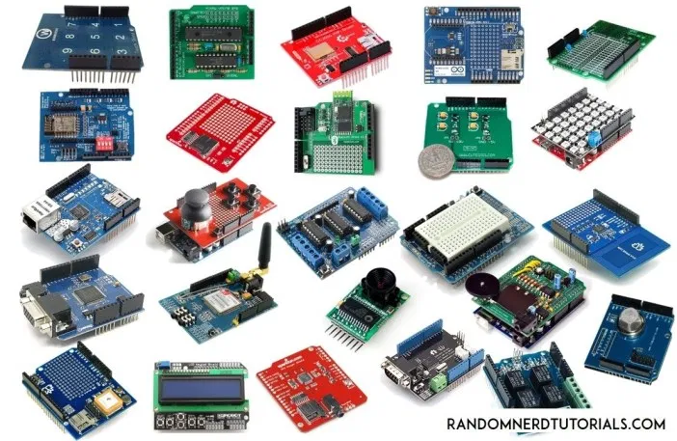
Microcontrollers

